Slide 1
Information Currencies
Genome 575: Fundamentals of Biomedical Instrumentation
Brian Beliveau

Slide 2
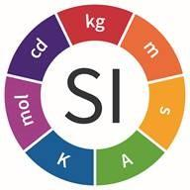
(re) Introductions
Name / pronouns
What you’re working on right now
Favorite SI base unit
https://www.nist.gov/pml/weights-and-measures/metric-si/si-units

Slide 3
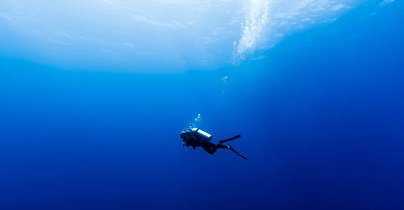
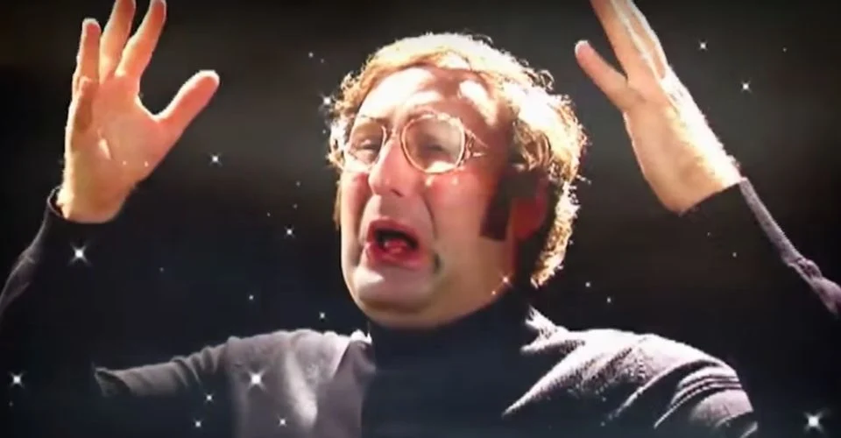
Goals for this class
Think about instruments in new ways
Dive deep
New angles
Gain a better of understanding of what is being measured and how it can mislead you
https://www.istockphoto.com/photo/scuba-diving-in-the-wild-blue-yonder-in-french-polynesia-gm484092196-71525013
https://static1.srcdn.com/wordpress/wp-content/uploads/2020/11/tim-and-eric-mind-blown.jpg?q=50&fit=crop&w=960&h=500&dpr=1.5

Slide 4
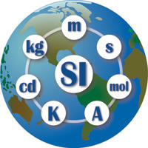
Le Systeme International d'Unites (SI)
Foundation of the metric system
Built on 7 base units + 7 associated constants. Assumed to be “mutually independent” (2019)
Many derived units
https://www.nist.gov/sites/default/files/styles/480_x_480_limit/public/images/2016/11/01/si-globe-logo.jpg?itok=9Z03oUtF

Slide 5

A guided tour of the SI base units
https://media.istockphoto.com/photos/travel-to-europe-tourist-looking-at-map-on-the-street-summer-holidays-picture-id1020217050?k=20&m=1020217050&s=612x612&w=0&h=7ldikMFS5XidjVHwYMnMRnfhXrSdqA3WRdUKkLYelIw=

Slide 6
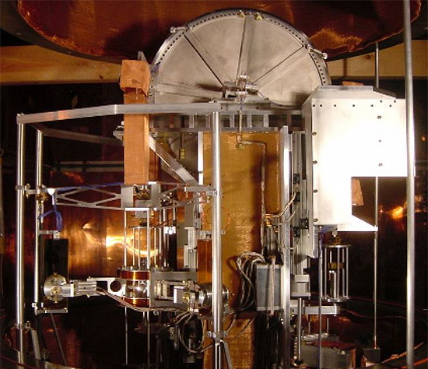
Kilogram (kg) : a unit for massive calculations!
Measurable: Mass
The quantity of matter in a physical body
Inertial mass: resistance to changes in velocity
Gravitational mass: defines strength of interaction with gravitational fields (weight)
Constant: h, 6.62607004 × 10⁻³⁴ m² kg / s
Planck’s constant
Energy = h * frequency
https://upload.wikimedia.org/wikipedia/commons/a/af/Watt_balance%2C_large_view.jpg
Kibble Balance

Slide 7
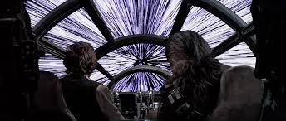
Meter (m) : a unit for lengthy journeys!
Measurable: Length
A measure of distance in a dimension
Constant: c, 299,792,458 m / s
Speed of light in a vacuum
s defined based on the Cesium standard (more soon!)
https://www.google.com/url?sa=i&url=https%3A%2F%2Fstarwars.fandom.com%2Fwiki%2FLightspeed%2FLegends&psig=AOvVaw2JW1S6KFHyEllGYWRdSznb&ust=1648597525352000&source=images&cd=vfe&ved=0CAsQjRxqFwoTCIiJgdL-6fYCFQAAAAAdAAAAABAD

Slide 8
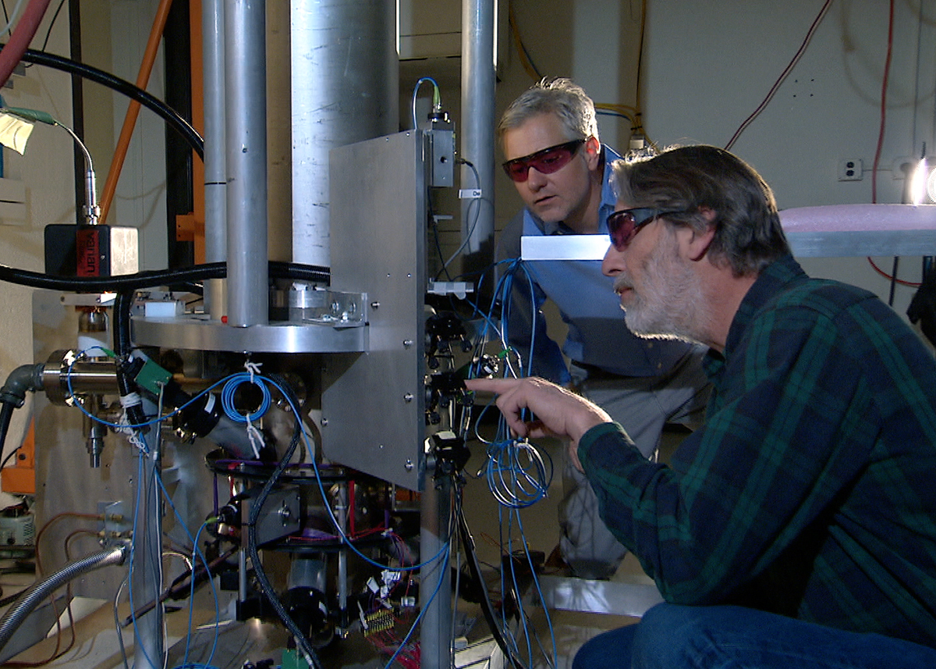
Second (s) : a unit for timeless experiences!
Measurable: Time
A measure of duration
Constant: ∆ν_{Cs}, 9,192,631,770 s⁻¹
A measure of the frequency of the relaxation of Cs133 (Spin F = 4) to Cs133 (F = 3)
https://upload.wikimedia.org/wikipedia/commons/4/43/NIST-F2_cesium_fountain_atomic_clock.jpg
“Atomic clock”

Slide 9
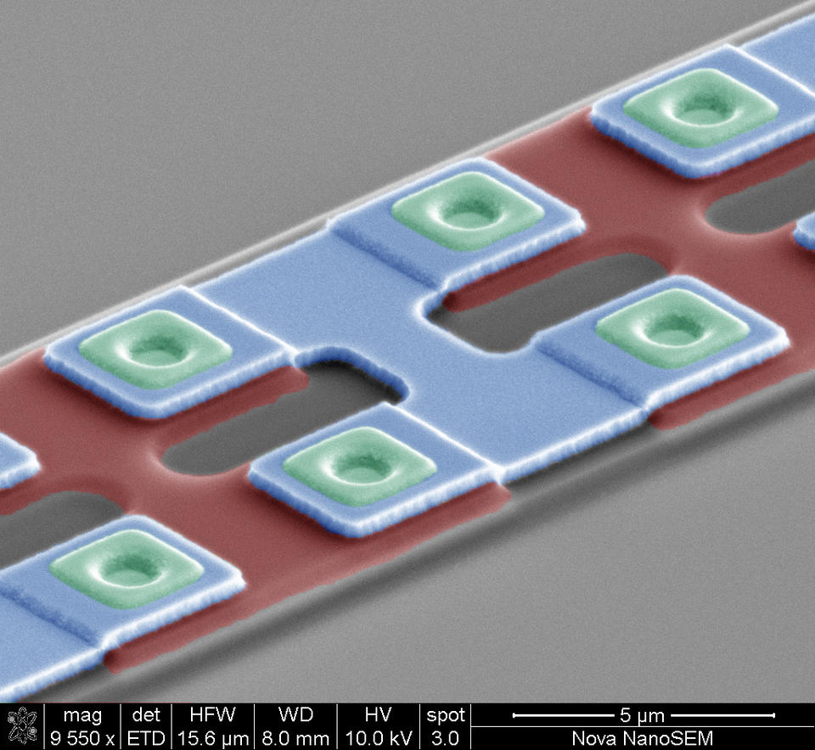
Ampere (A) : a unit for shocking discoveries!
Measurable: Electric current
A measure of charge flow through a conductor or space
Constant: e, 1.602176634 × 10⁻¹⁹ coulombs
Elementary charge (proton⁺ / electron⁻)
1 coulomb = 1 A * 1 s
The value of e depends on h (via Ohm’s law V = IR and measures of V, R), ∆ν_{Cs}
https://www.nist.gov/sites/default/files/styles/960_x_960_limit/public/images/2017/08/31/JJ-9550x-60deg_002_colored.jpg?itok=SKo9MpkM
Josephson junction (measures V)

Slide 10
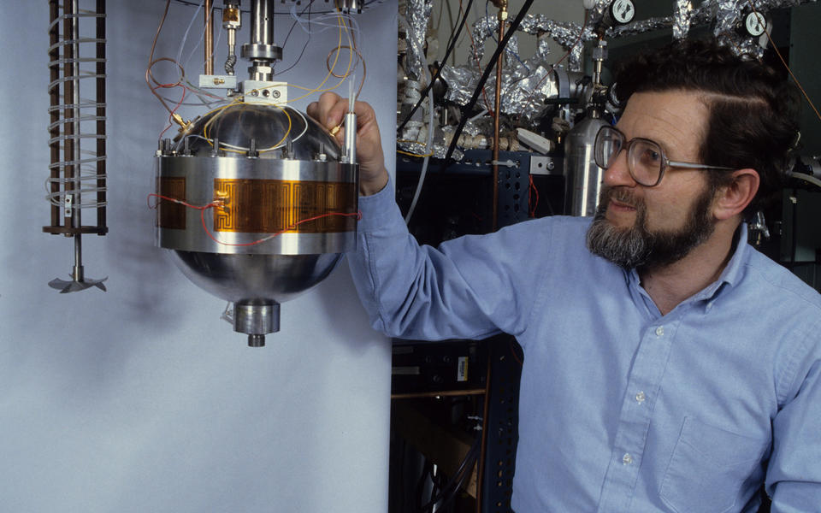
Kelvin (K) : a unit for heartwarming events!
Measurable: Temperature
A measure of thermal energy
Constant: k, 1.380649×10⁻²³ J / K
Boltzmann constant
1 joule (J) = 1 (kg * m²) / s²
k was measured empirically using an “acoustic resonator”
https://www.nist.gov/sites/default/files/styles/960_x_960_limit/public/images/2017/12/20/mike_and_gas_constant_resonator_img002_resized.jpg?itok=N4xGI-nI

Slide 11
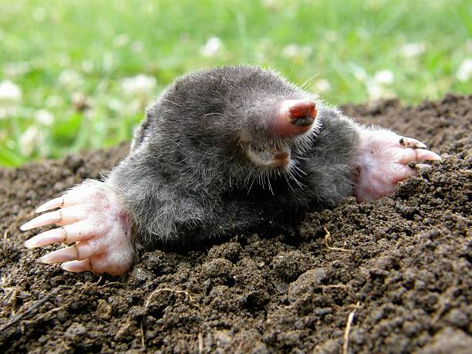
Mole (mol) : a unit for numerous possibilities!
Measurable: Amount of substance
A measure of how many elementary entities of a given substance are in an object/sample
Constant: N_{A}, 6. 02214076 x 10²³ particles / mol
Avogadro’s number
Value set by the International Bureau of Weights and Measures
https://www.google.com/url?sa=i&url=https%3A%2F%2Fwww.istockphoto.com%2Fphotos%2Fmole-animal&psig=AOvVaw3-kGEh5rmx2g4bcchmx9k_&ust=1648749197129000&source=images&cd=vfe&ved=0CAsQjRxqFwoTCMDImcWz7vYCFQAAAAAdAAAAABAD

Slide 12
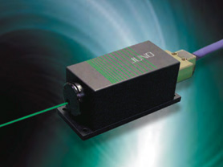
Candela (cd) : a unit for illuminating analyses!
Measurable: Luminous intensity
A measure of luminous power per unit solid angle (ie, some FOV) emitted by a point light source
Constant: K_{cd}, 683 lumens / W
Based on the luminous efficacy of monochromatic radiation of frequency 540 × 10¹² Hz (~555 nm)
FWIW in optics we just use W
https://www.ksoc.co.jp/en/seihin/lasers/img/dpss.jpg

Slide 13
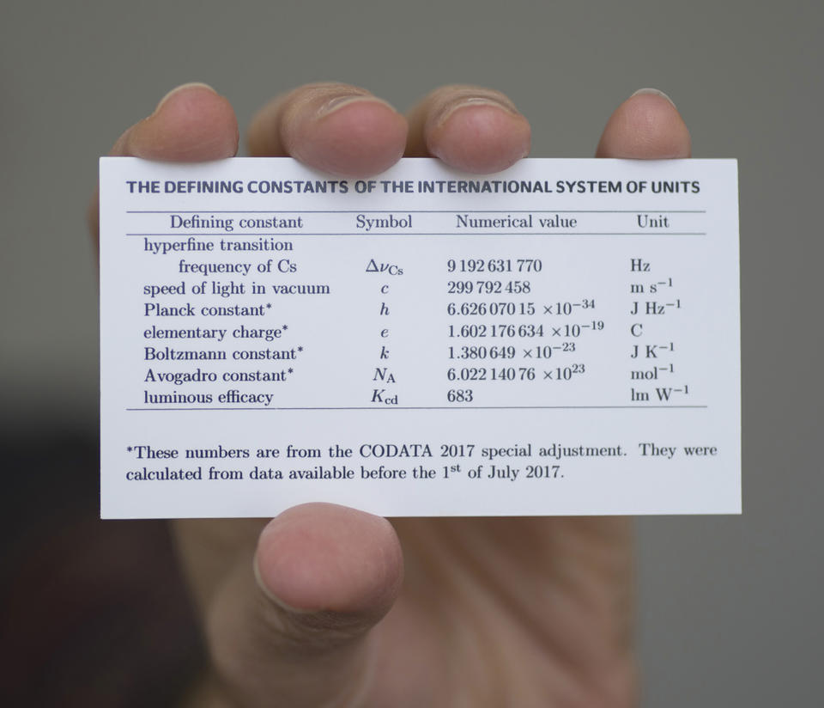
Can’t get enough of the SI constants?
https://www.nist.gov/sites/default/files/styles/960_x_960_limit/public/images/2018/10/30/17pml015_si-constants-card.jpg?itok=Ecezgy_j

Slide 14
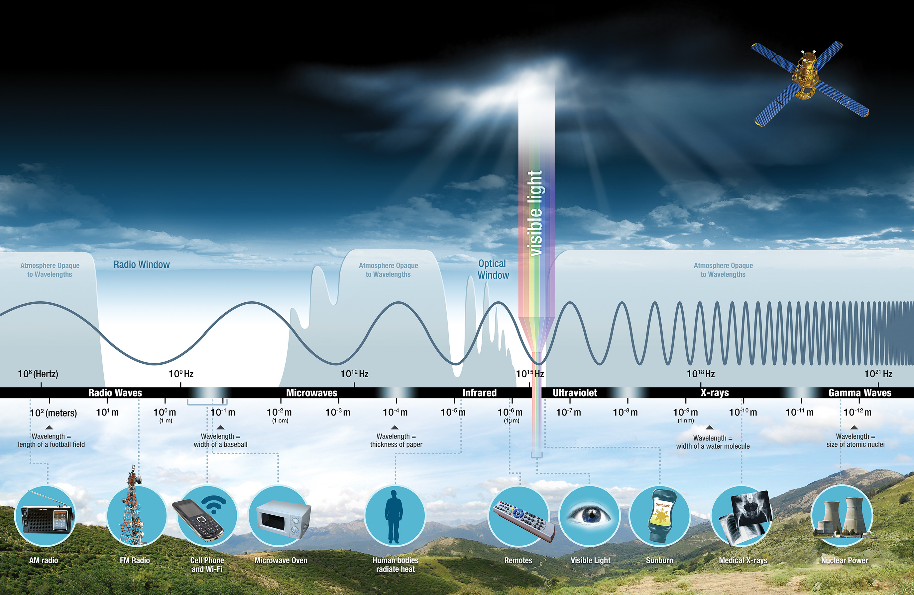
Electromagnetic radiation
What is your favorite part of the EM spectrum?
https://science.nasa.gov/files/science-pink/s3fs-public/styles/science_news_hero_image/public/thumbnails/image/intro-1.jpg?itok=iRsuB2Q7

Slide 15
Electromagnetic radiation
Wavelength (𝝀) = c (velocity) / frequency (f)
Greater f == more energy
https://science.nasa.gov/files/science-pink/s3fs-public/styles/science_news_hero_image/public/thumbnails/image/intro-1.jpg?itok=iRsuB2Q7

Slide 16
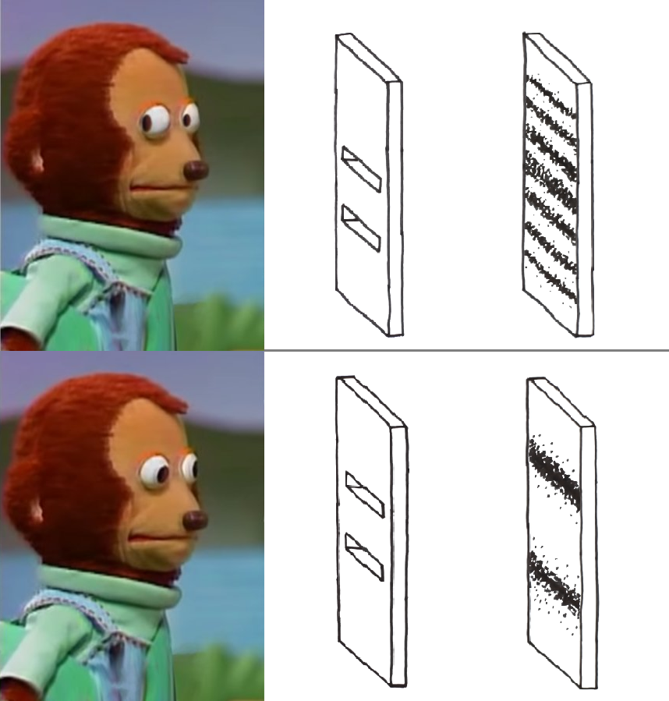
What is going on here?
https://i.redd.it/pz6s3irlge861.png

Slide 17
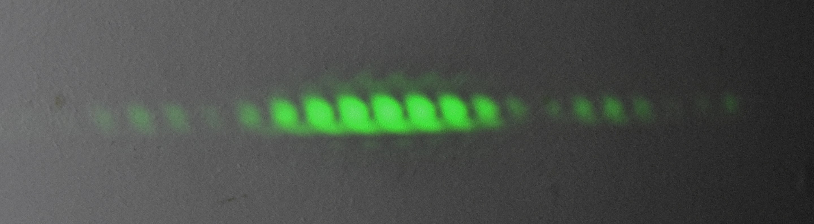
Wave-particle duality
Light waves interfere with each other -> diffraction pattern
Place a detector at a slit, diffraction pattern disappears (!!)
Electromagnetic radiation behaves simultaneously as a wave and a particle (photon)
https://i.redd.it/pz6s3irlge861.png, https://upload.wikimedia.org/wikipedia/commons/thumb/3/39/Young%27s_slits.jpg/2880px-Young%27s_slits.jpg, https://static1.srcdn.com/wordpress/wp-content/uploads/2020/11/tim-and-eric-mind-blown.jpg?q=50&fit=crop&w=960&h=500&dpr=1.5

Slide 18
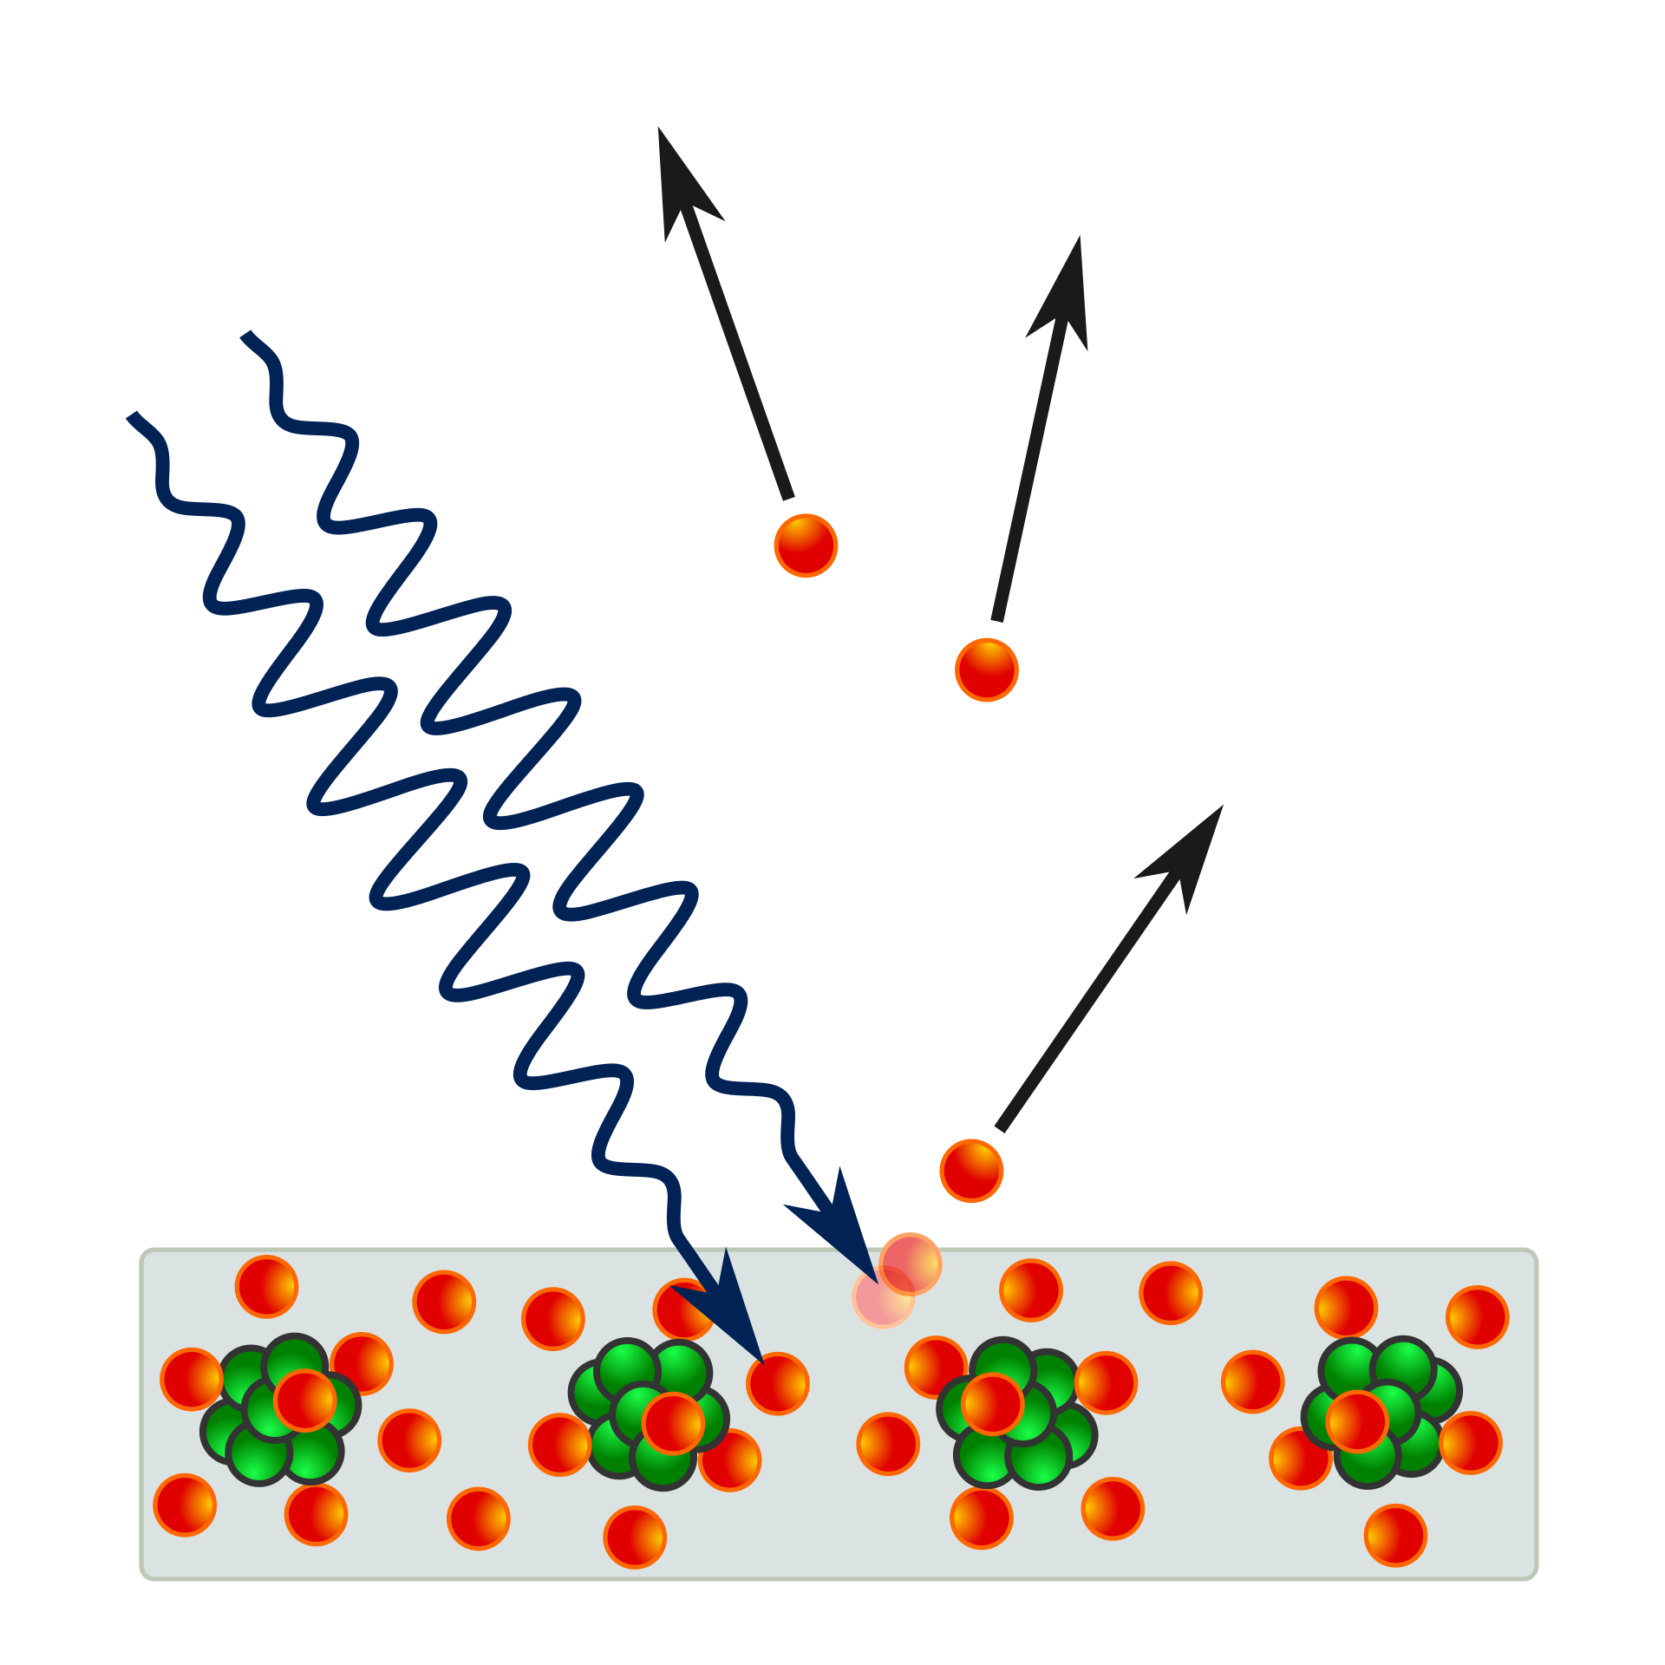
Photoelectric effect
EM radiation (photons) in, (photo)electrons out
Energy of incident EM must be above a threshold, dependent only on f
E = h * f
https://upload.wikimedia.org/wikipedia/commons/thumb/a/a6/Photoelectric_effect_in_a_solid_-_diagram.svg/1920px-Photoelectric_effect_in_a_solid_-_diagram.svg.png

Slide 19


Trivia time!
Teams of 2–3 (card draw)
Phones and computers away
https://i2.wp.com/www.evolvedcontact.com.au/articles/wp-content/uploads/2020/04/81-817751_quiz-time-announcement-poster-neon-signboard-vector-quiz.png?fit=1024%2C417&ssl=1, https://scuffedentertainment.com/wp-content/uploads/2021/03/pub-trivia-quiz.jpg

Slide 20
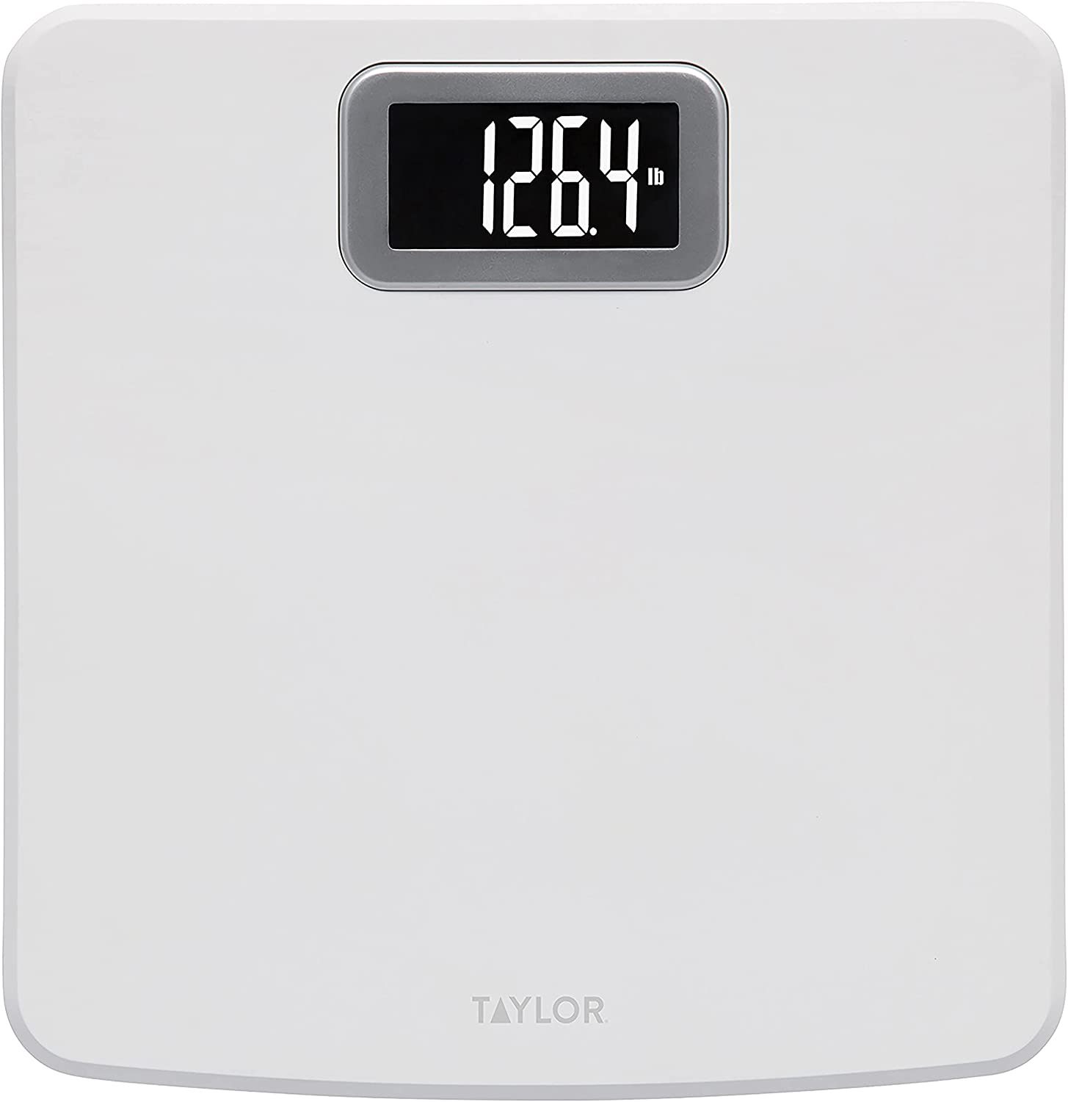
Question 1 (10 mins)
Digital bathroom scale
What does this actually measure?
https://m.media-amazon.com/images/I/61ZOy1oalYL._AC_SL1500_.jpg

Slide 21
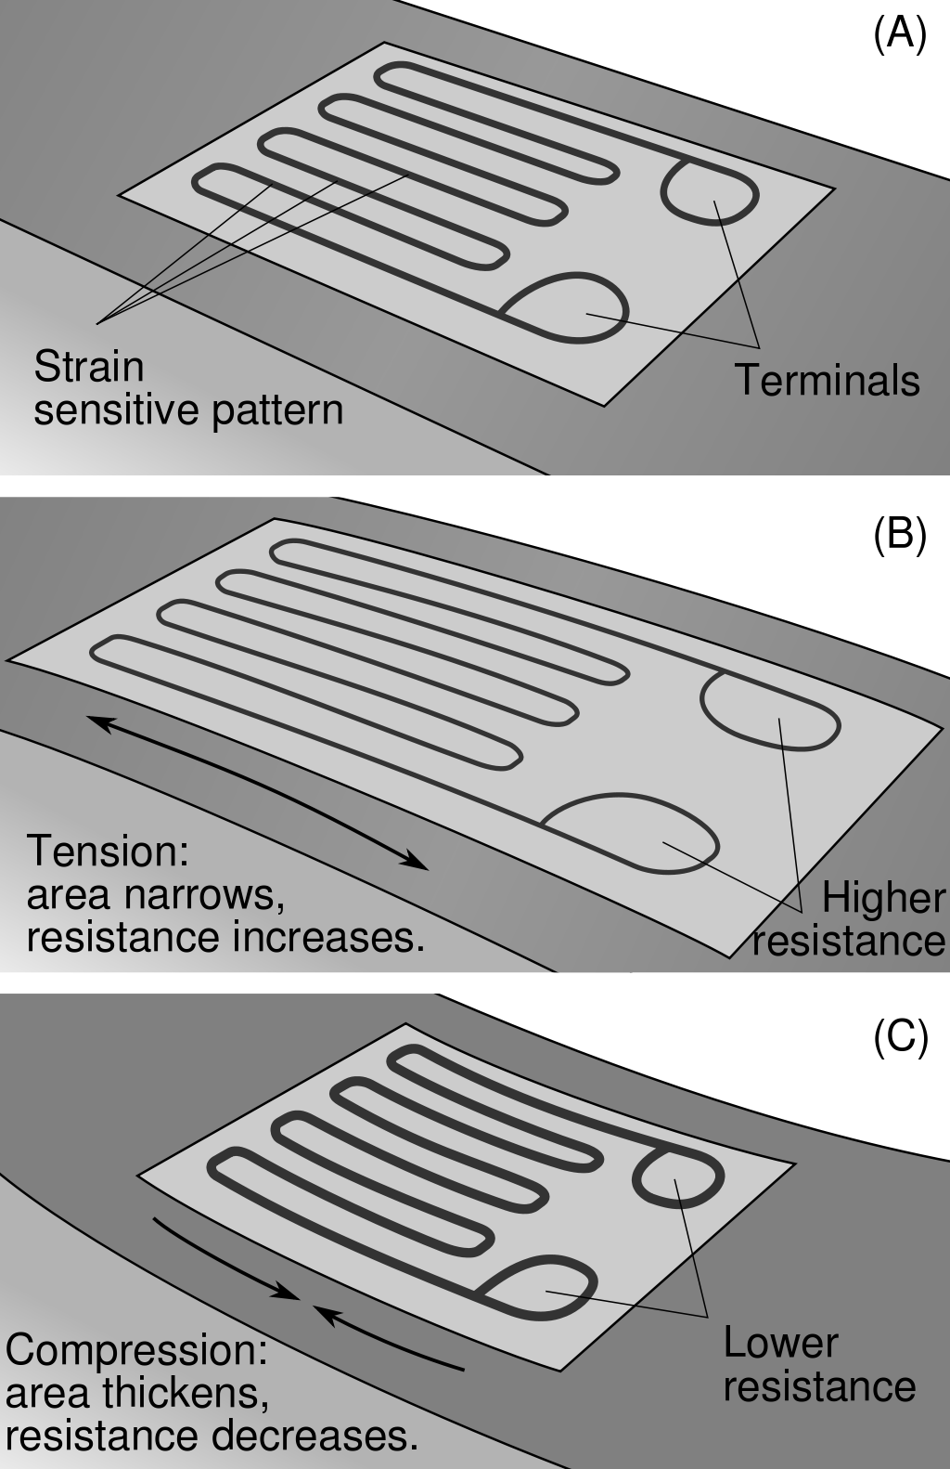
Answer 1
A strain gauge changes electrical resistance (R) as a function of deformation
Changes in R are converted to digital units
Approach relies on calibration
https://m.media-amazon.com/images/I/61ZOy1oalYL._AC_SL1500_.jpg, https://upload.wikimedia.org/wikipedia/commons/thumb/c/c3/StrainGaugeVisualization.svg/1024px-StrainGaugeVisualization.svg.png

Slide 22
Concept: transducers
Strain gauges are examples of transducers
Transducers convert energy from one form to another
Here: weight (kg * g) in, ∆R (V / A) out
SI base units: kg → A
https://m.media-amazon.com/images/I/61ZOy1oalYL._AC_SL1500_.jpg, https://upload.wikimedia.org/wikipedia/commons/thumb/c/c3/StrainGaugeVisualization.svg/1024px-StrainGaugeVisualization.svg.png

Slide 23
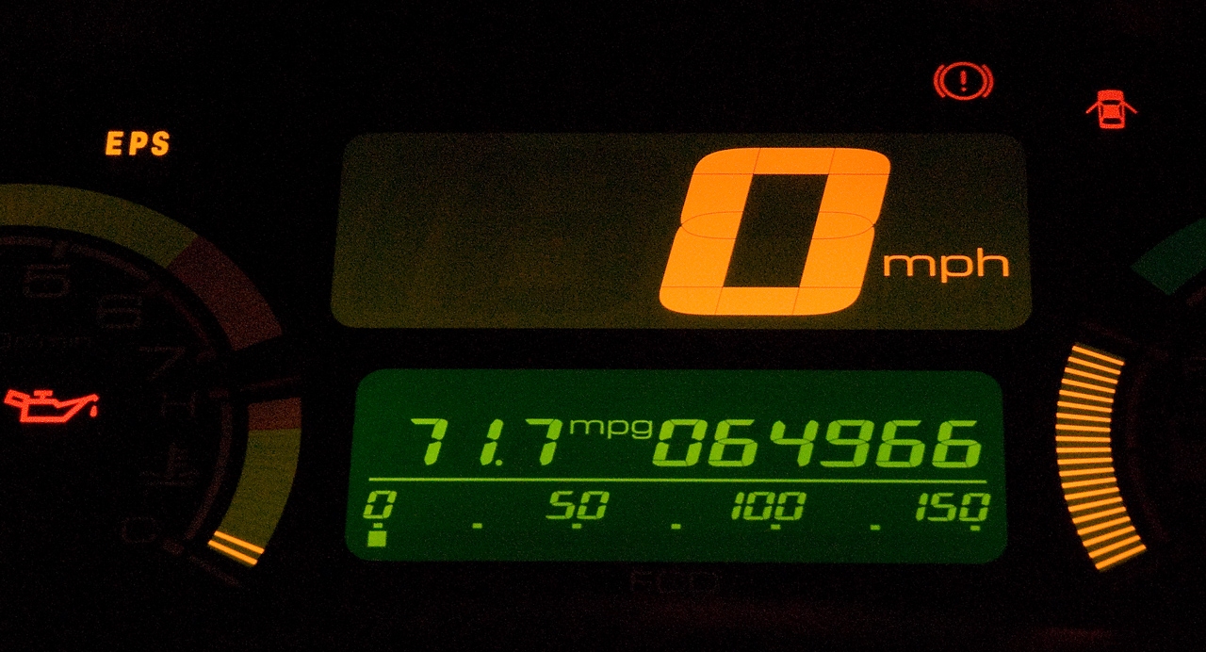
Question 2 (10 mins)
Car speedometer
What does this actually measure?
https://upload.wikimedia.org/wikipedia/commons/c/cb/717mpg.jpg

Slide 24
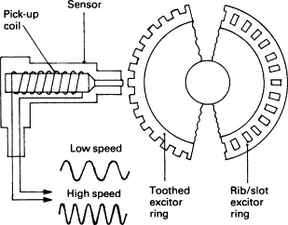
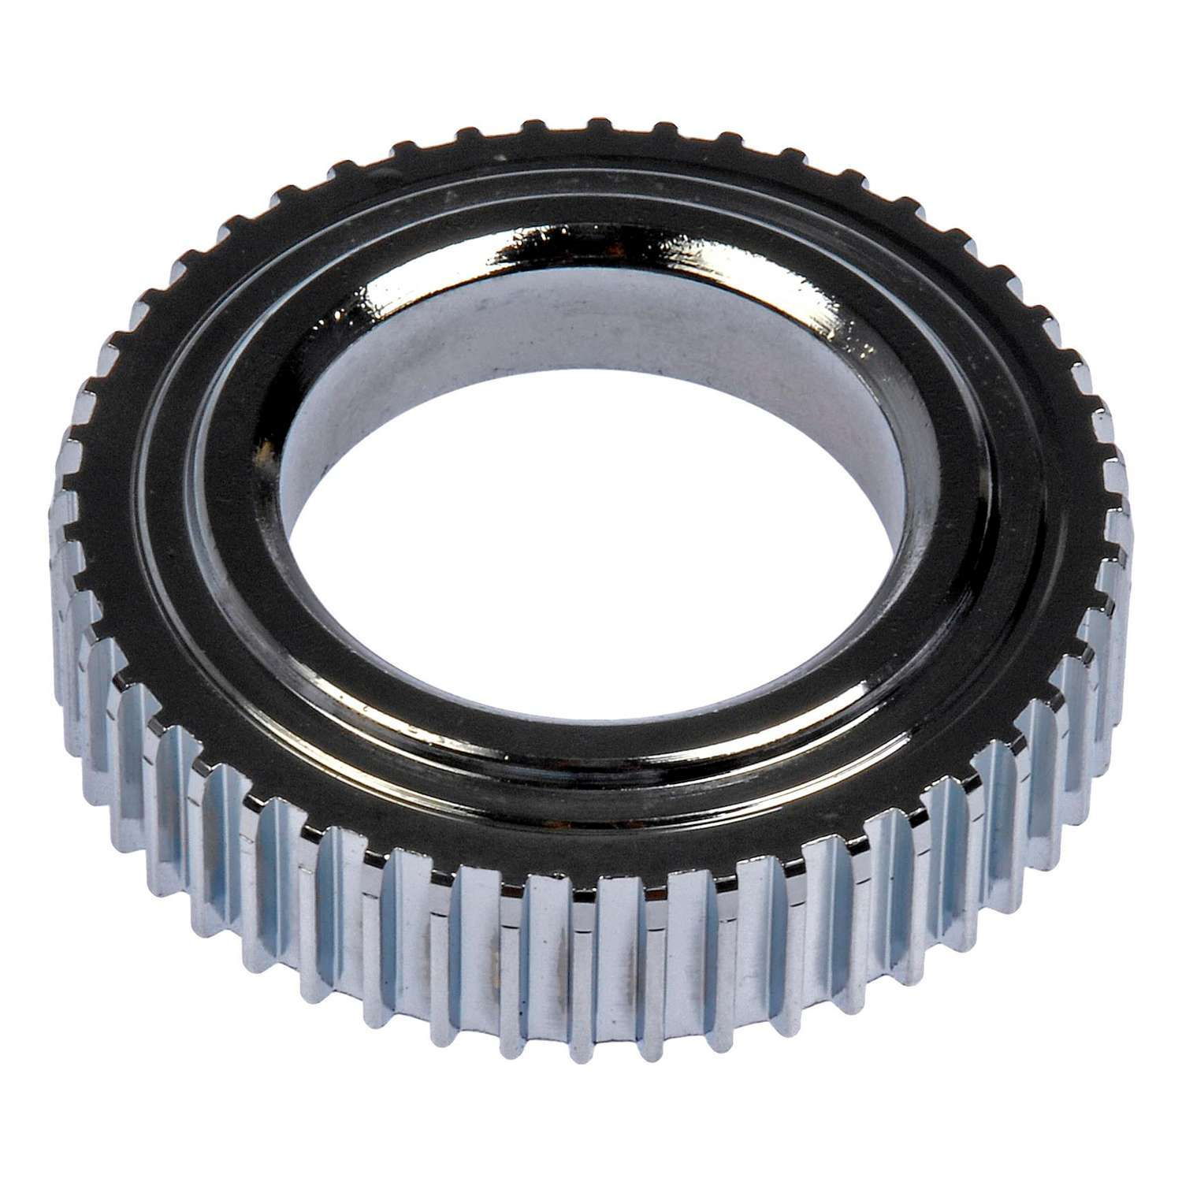
Answer 2
Ferromagnetic toothed ring spins with axel or drive shaft
Sensor contains electromagnet
Teeth distort magnetic field -> creates alternating electrical field
Changes in spin speed -> changes in f of alternating V
Approach relies on calibration
Tone wheel
https://ars.els-cdn.com/content/image/3-s2.0-B9780750651318500129-f11-40-9780750651318.gif, https://i5.walmartimages.com/asr/4fbb556a-dcde-46fe-88f7-dc4da8676bdb.736184df7fa4885998187990b6299827.jpeg

Slide 25
Another conversion
Velocity is desired readout
Angular velocity of driveshaft/axel a proxy
Velocity (m / s) in, V (Ω * A) out
SI base units: (m / s) → A
Tone wheel
https://ars.els-cdn.com/content/image/3-s2.0-B9780750651318500129-f11-40-9780750651318.gif, https://i5.walmartimages.com/asr/4fbb556a-dcde-46fe-88f7-dc4da8676bdb.736184df7fa4885998187990b6299827.jpeg

